Slide 1
BIG DATA HEALTH SCIENCE CASE COMPETITION
STANDARD DEVIANTS

Slide 2
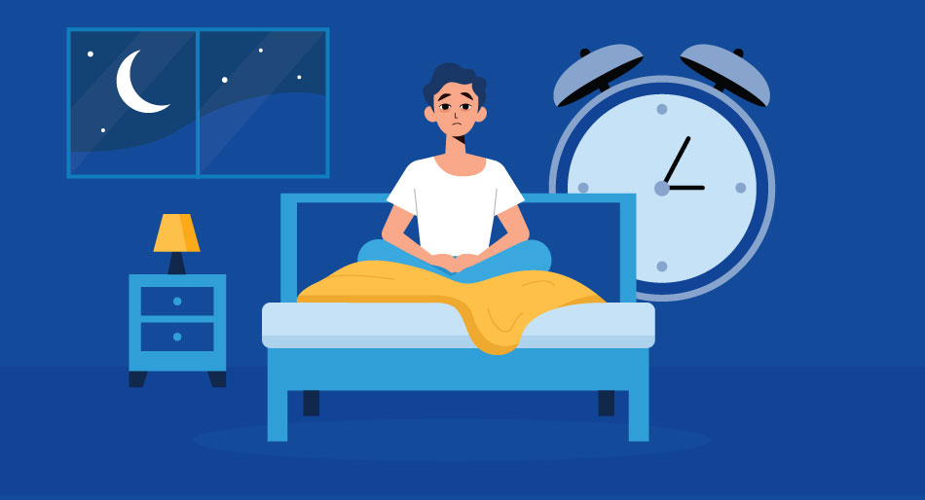
BACKGROUND
Sleep disorders affect 70 million Americans
Undiagnosed cases lead to higher healthcare costs and reduced productivity
Translational research with rodents informs our understanding of human biology

Slide 3
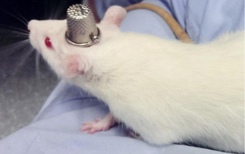
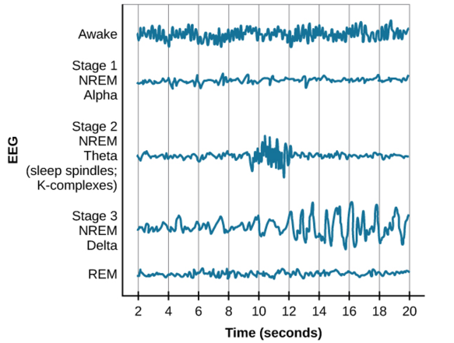
PROBLEM STATEMENT
EEG is a technique for monitoring electrical brain activity in real-time and is effective in helping identify the distinct stages of sleep cycles
As it currently stands, we have to employ a dedicated expert to manually annotate an EEG chart
This is both resource-intensive and time-consuming
With an obvious need for a more scalable and cost-effective solution, we aim to develop an automated system for efficient EEG data processing
Notes:
The answer lies with this rat in a hat

Slide 4
THE DATA
Notes:
8 rats
500 recordings per second
24 hours

Slide 5
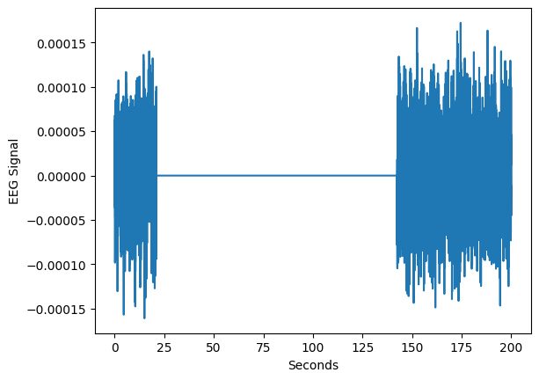
LIMITATIONS OF THE DATA
Single-Channel EEG
Uncertainty in reading
Almost no spatial resolution

Slide 6
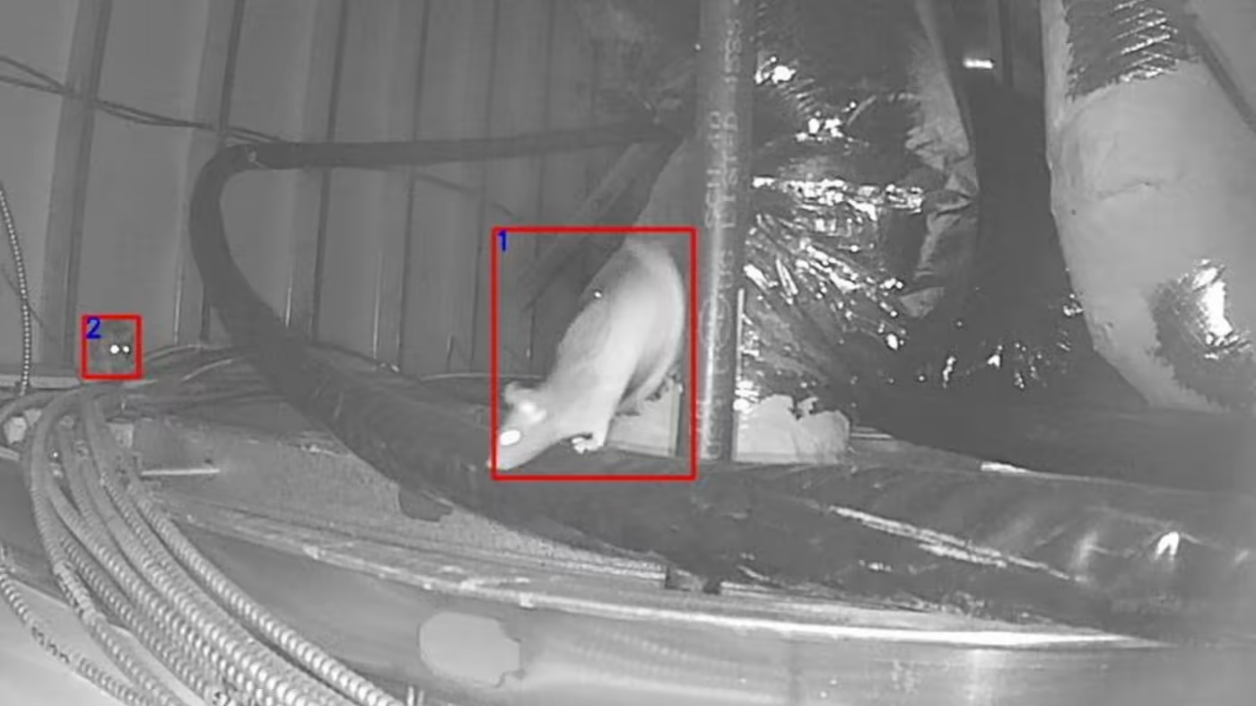
LIMITATIONS OF THE DATA
Lack of Features
EEG Readings are the only available information
No information relating to the rats’ activity
No information relating to the time of day
Notes:
If we are trying to predict sleep stage, then motion is highly relevant
This could also help to limit artifacts: if we know when there are greater electrical impulses from muscle contraction, we can better control for it

Slide 7
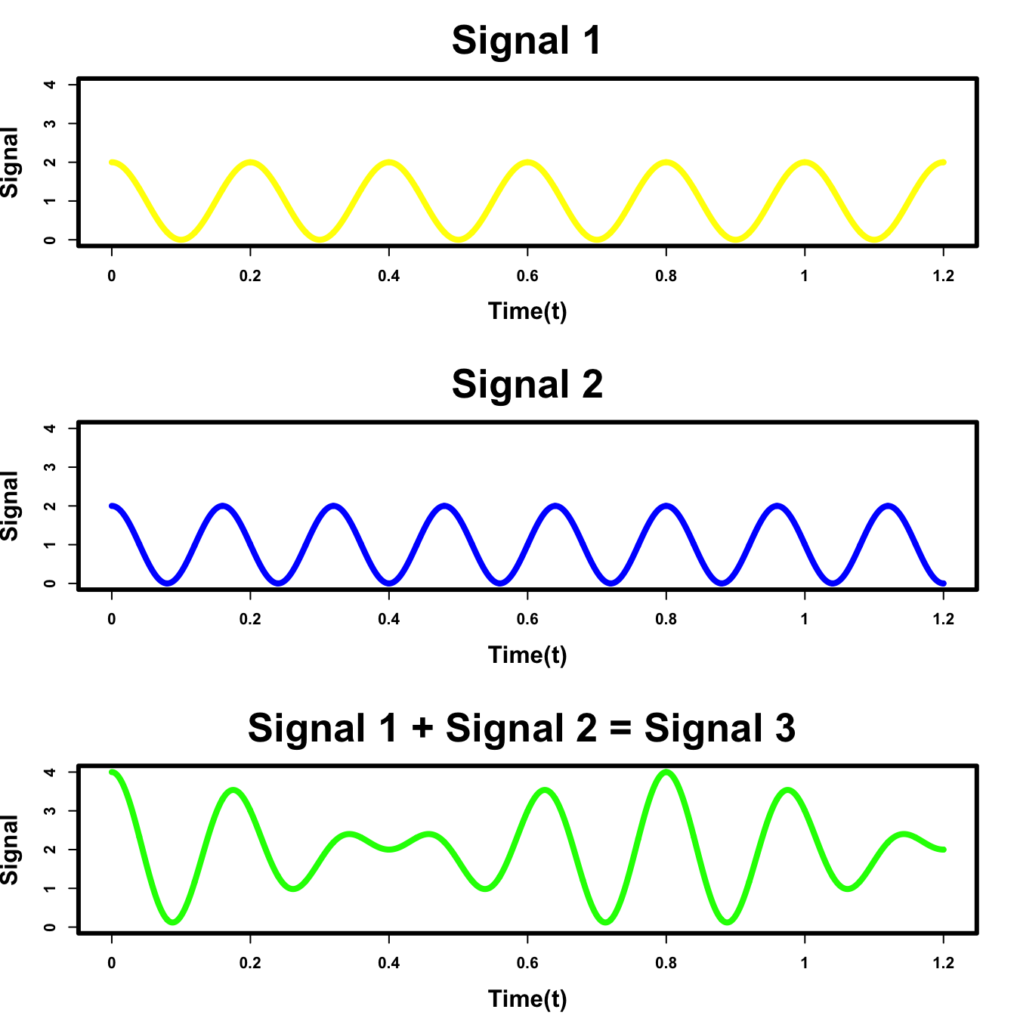
DATA PROCESSING
EEG data records the electrical signal from all brain activity, even that which is insignificant, making it very noisy
Here, we have the combination of just two waves (yellow and blue), which would be read as a single output (the green wave) since the electrical outputs of each are indistinguishable
Notes:
You can imagine how this become increasingly complicated with more than two signals

Slide 8
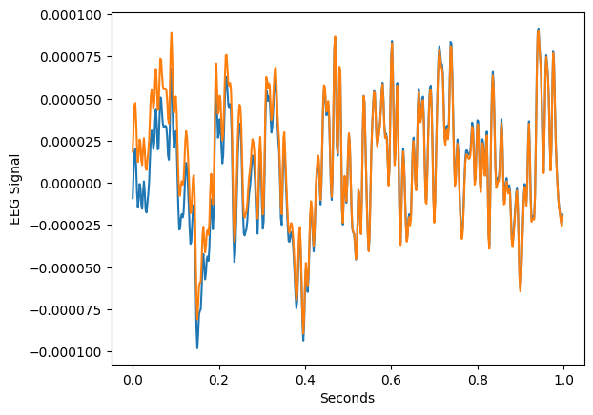
DATA PROCESSING
Our first step in the solution to dirty data is applying a smoothing function, in this case the Butterworth filter because of its common use in EEG data
This filter splits our wave into its different frequency components and then blunts some of those frequencies based on specified criteria
It performs these modifications in chunks (different time intervals)
Notes:
We perform the opposite operation as the previous slide, splitting what was the green wave into its components

Slide 9
DATA PROCESSING
We specifically constrained the Butterworth filter to isolate waves with frequencies between 0.5 Hz and 200 Hz
This is the range of brain wave frequencies observed for rats
Notes:
This gives us a high degree of confidence that the observed pattern is indeed from the brain, rather than artifacts

Slide 10
DATA PROCESSING
To obtain our final dataset, we performed a Fourier transform to split the smoothed wave into its individual frequencies.
We selected the 5 greatest amplitudes and their corresponding frequencies, recording this information.
This process was performed in chunks of one epoch of data (10s) at a time
Notes:
Around 2500 waves created
We sorted by amplitude because a larger amplitude contributes to a given wave more, it explains more of the up and down variation in our EEG, which makes it a better explanatory variable

Slide 11
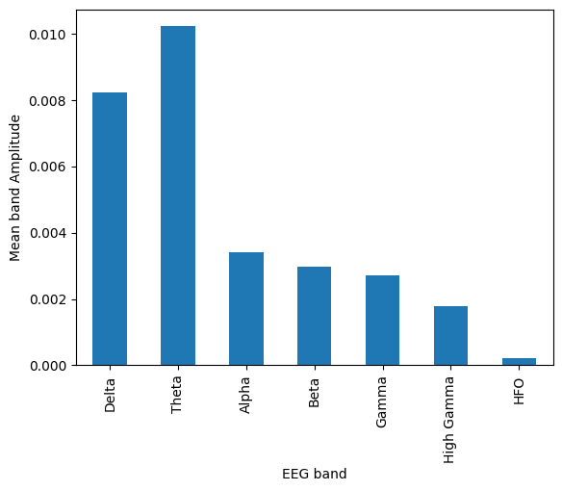
DATA PROCESSING
We then grouped the individual frequencies produced by the Fourier transform based on their classifications according to literature
The value reported is the mean amplitude for each group
Notes:
'Delta': (1, 4), Theta': (5, 9), 'Alpha': (10, 15)

Slide 12
MODEL FEATURES
 | amplitude_1 | … | amplitude_5 | frequency_1 | … | frequency_5 | average_delta | average_theta | …
epoch_1
epoch_2
epoch_3
Notes:
'Delta': (1, 4), Theta': (5, 9), 'Alpha': (10, 15)

Slide 13
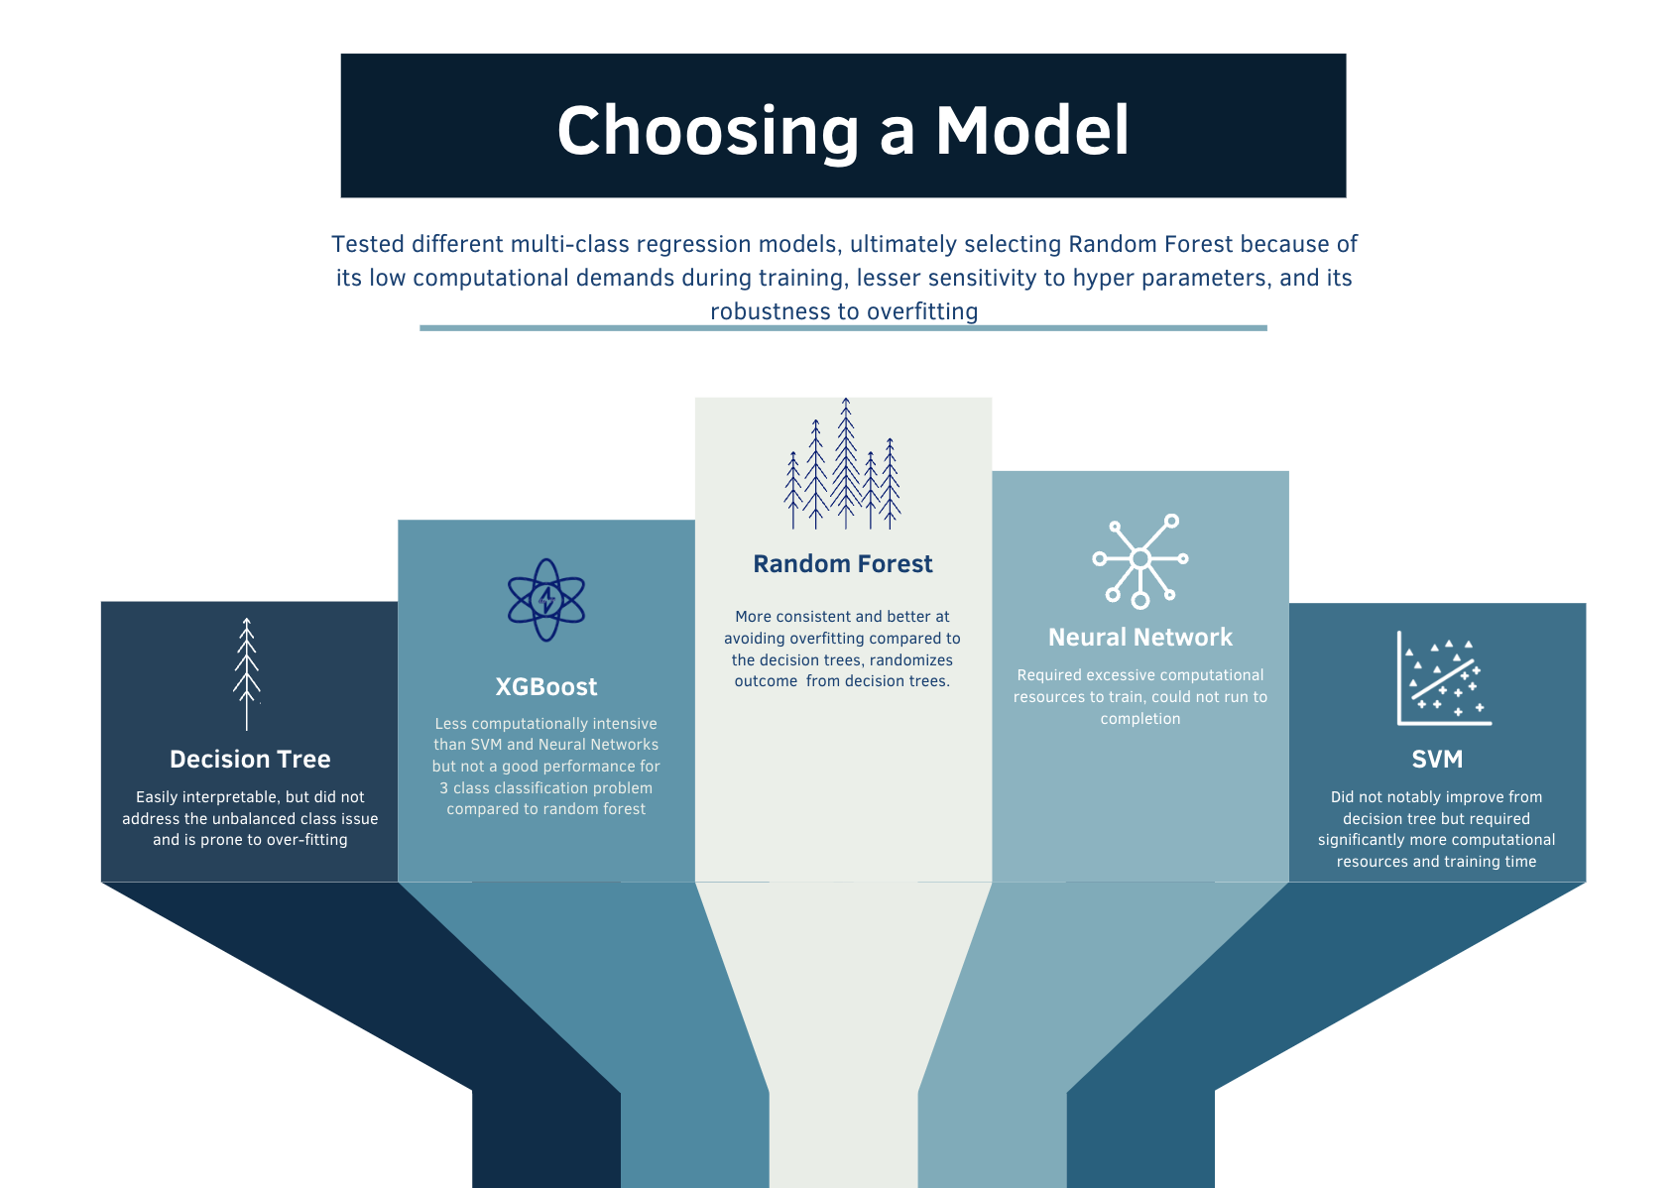

Slide 14
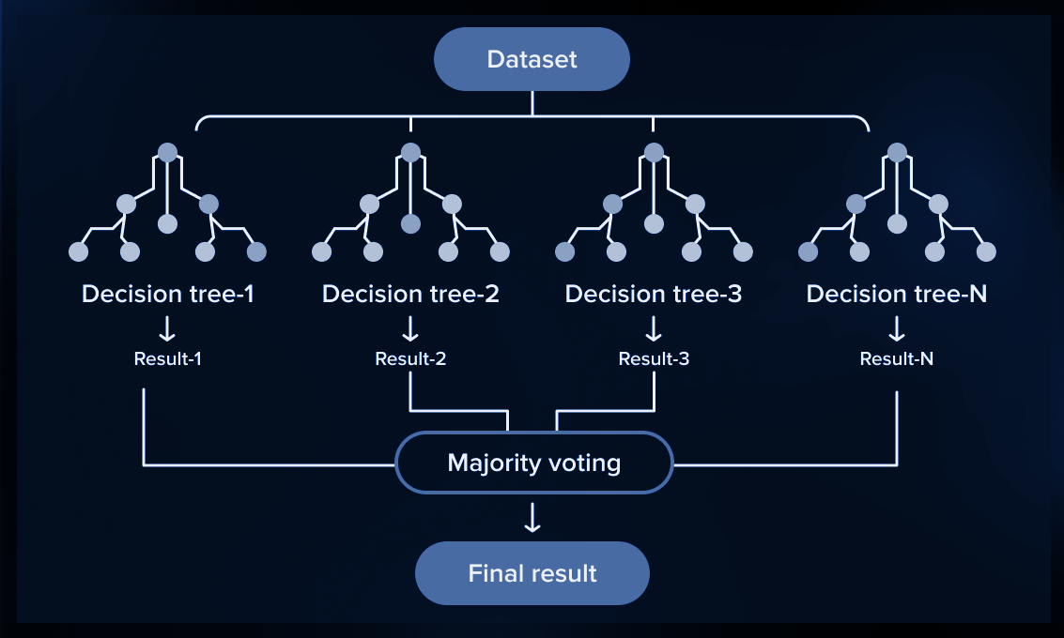
OUR MODEL
Once we had our features, we used the Random Forest model to predict the state of sleep a rat was in at a given time
Random Forest makes a prediction by generating many random decision trees, allowing them to make their own predictions, and then considering the majority consensus

Slide 15
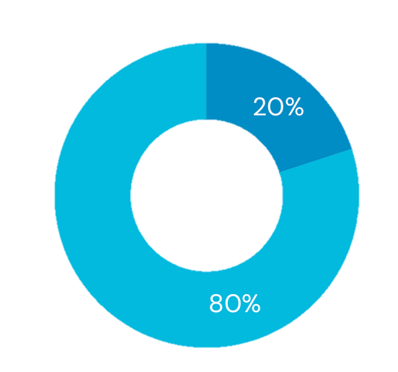
EVALUATION
We partitioned our data into an 80% training set and a 20% validation set, used to test our model. We then evaluated the model’s performance by calculating the F1 Score for each sleep stage.
The F1 score provides a more balanced measure of accuracy when the predicted variable is imbalanced, as it is in our case.

Slide 16
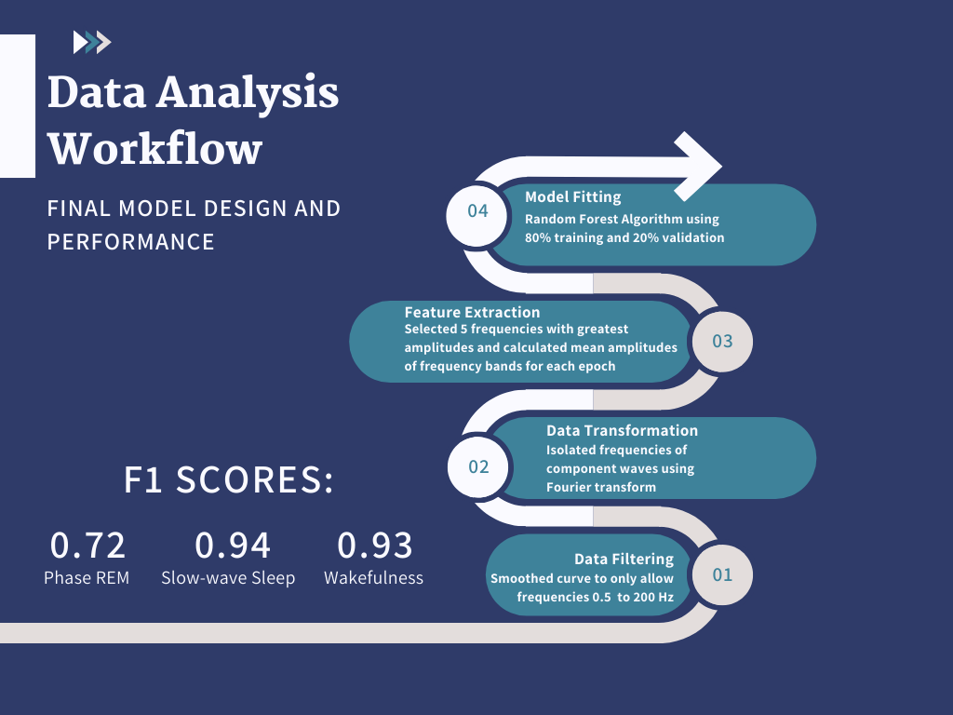

Slide 17
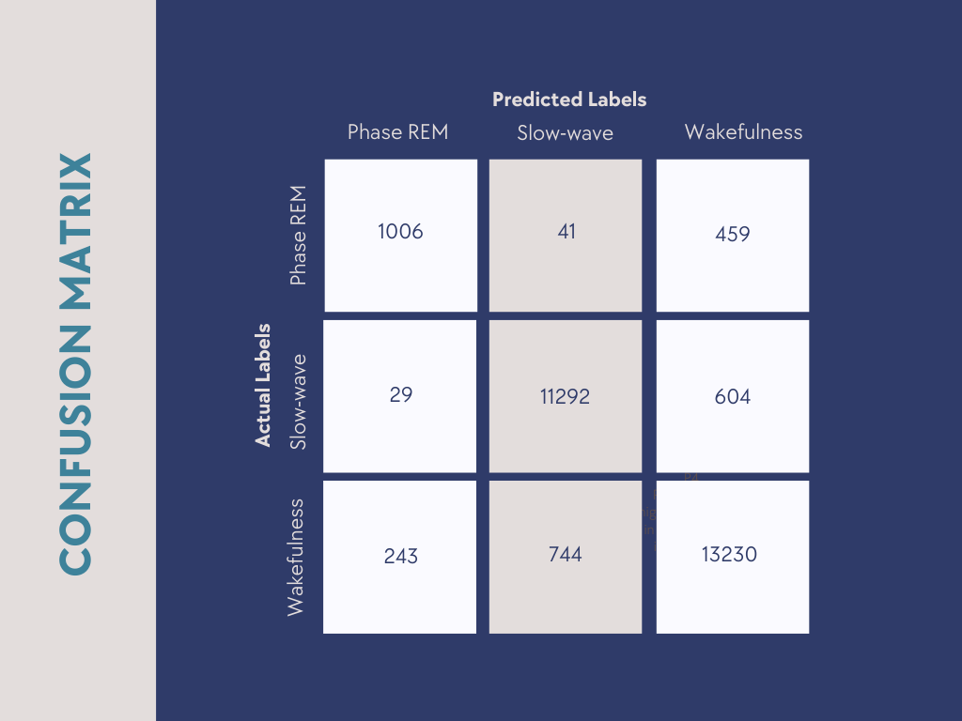
RESULTS

Slide 18
CHALLENGES WE FACED
POTENTIAL IMPROVEMENTS
Computationally intensive
Difficult to visualize the decomposition of the EEG wave into its individual frequencies
Exploration of niche techniques and packages
Direct research towards task-specific areas first
Run scripts on small subset of data to ensure functionality

Slide 19
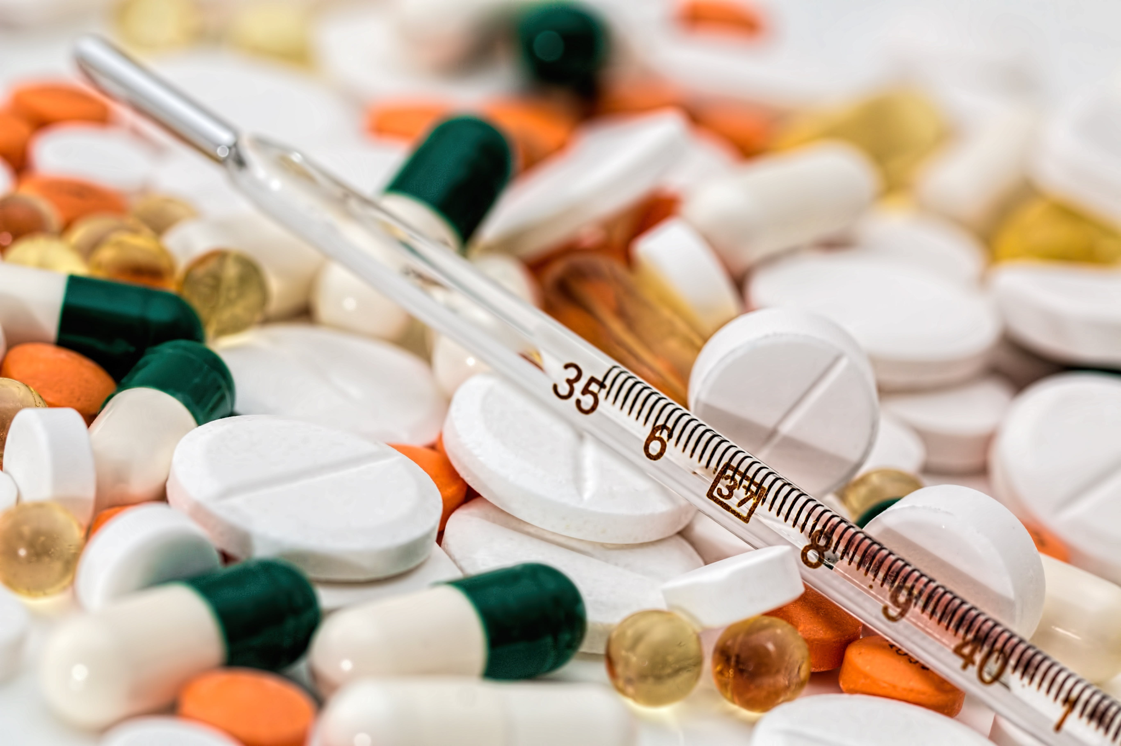
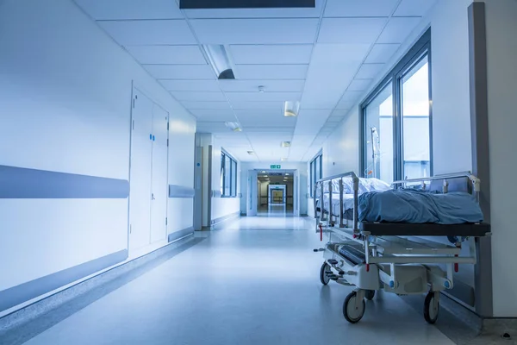
REAL-WORLD APPLICATIONS

Slide 20
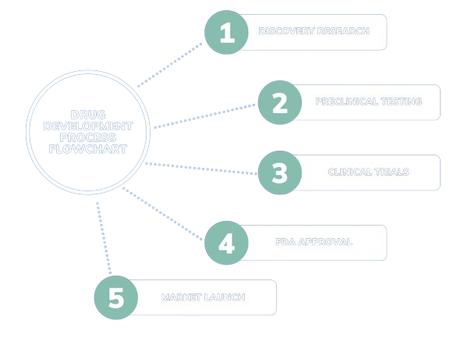
PHARMACEUTICAL INDUSTRY APPLICATIONS & REVENUE IMPACT
Our research offers an understanding of how medications impact various sleep stages
Pharmaceutical companies can use this insight to optimize drug formulations for efficacy
Tailoring drug development strategies can lead to cost reductions by streamlining the research & development process
Medications with proven efficacy in treating sleep disorders can experience increased market success

Slide 21
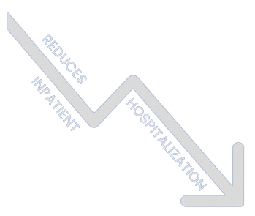
HOSPITAL APPLICATIONS
& FINANCIAL IMPACT
Precision in diagnosis allows doctors to tailor treatments to address specific stages of sleep, contributing to better patient outcomes
Targeted treatments based on accurate diagnoses lead to a reduction in inpatient hospitalizations
Hospitals can allocate resources more efficiently by addressing the specific needs of patients at different sleep stages
The reduction in hospital stays not only improves patient quality of life but also results in significant cost savings for healthcare systems

Slide 22
ACADEMIC APPLICATIONS
Give rise to new data collection techniques and deeper insights into animal behavior and its modification by environmental and genetic factors
Potential for further insight and research into epileptic disorders in model animals and by extension humans

Slide 23
HOW CAN WE TAKE THIS RESEARCH FURTHER?
Expand data collection by using additional physiological measures, such as heart rate and movement data
Increase complexity of the model by considering a Convolution Neural Network (CNN) approach
Investigate if the recorded markers show patterns consistent with sleep disorders
Extend the research's applicability by translating findings into human clinical trials
Establish a baseline expectation of concordance between annotators
Notes:
cohen's kappa

Slide 24
Q&A

